Slide 1
Turkish Statistical Institute (TurkStat)
TurkStat is responsible for ;
Data processing
Evaluation,
Publication and
Dissemination of agricultural statistics.
The Agriculture Statistics Department is responsible for the production of agricultural statistics in TurkStat.

Slide 2
Pursuant to Decree Law No. 639 on the Organisation and Tasks of the Ministry of Food, Agriculture and Livestock, annual data collection for crop production and animal production statistics and monthly agricultural price statistics are performed by the Province and District Directorates of MoFAL.

Slide 3
Province and District Directorates of MoFAL. Within MoFAL, the Geographical Information Systems Department under the General Directorate of Agricultural Reform (GDAR) is assigned with the task of collecting agricultural data.
For this purpose, the Statistical Data Network (SDN), a web-based data system for data collection, has been established by MoFAL and the 81 Province and 903 District Directorates enter data into this system. SDN data is jointly analysed by MoFAL and TurkStat, and published by TurkStat.

Slide 4
Within MoFAL, the Geographical Information Systems Department under the General Directorate of Agricultural Reform (GDAR) is assigned with the task of collecting agricultural data.
For this purpose, the Statistical Data Network (SDN), a web-based data system for data collection, has been established by MoFAL and the 81 Province and 902 District Directorates enter data into this system. SDN data is jointly analysed by MoFAL and TurkStat, and published by TurkStat.

Slide 5
Present administrative records at MoFAL
Farmers Registry System (FRS)
Controlled Greenhouse and Viticulture Records
Veterinary Information System and Vaccine Records (TURKVET)
Organic Farming Information System (OTBİS)
National Milk Recording System
General Directorate of Livestock Records

Slide 6
The main variables are compiled in FRS
The residence address of Agricultural holding
Business address of Agricultural holding
The presence of land
The presence of animals
The presence of agricultural equipment and machinery
Other activities of the Agricultural holding

Slide 8
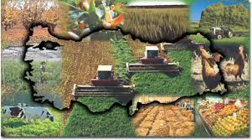
Agricultural Statistics Department
Agricultural Production Statistics Group,
Agricultural Structure and Economic Accounts Group

Slide 9
Agricultural Production Statistics Group is responsible for the following subjects;
Crop Production Statistics
Agricultural Equipment and Machinery
Statistics
Animal Production Statistic
Fisheries Statistics
Forestry Statistics
Organic Agriculture Statistics
Balance Sheets

Slide 10
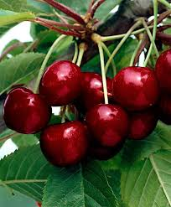
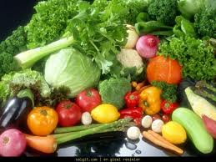
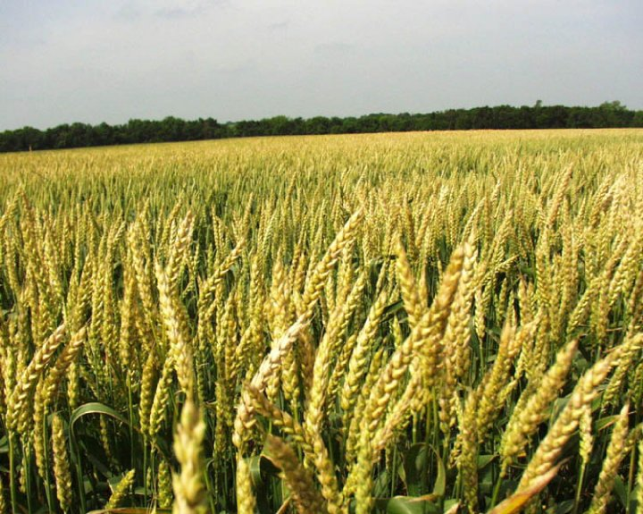
1- Crop Production Statistics

Slide 11
Current Status
The elaboration of agricultural statistics is a mainly joint task of Turkish Statistical Institute (TurkStat) and Ministry of Food, Agriculture and Livestock (MoFAL).
MoFAL and TurkStat have a long tradition of cooperation for the production of agricultural statistics.
There are 2.200 000 agricultural holdings according to the Farmers Registry System (FRS)

Slide 12
Transactions coverage: In crop production statistics, statistics are produced in following topics:
-Cereals and other field crops
-Vegetables
-Fruits, beverage and spice crops
-Production in under protective cover area
-Ornamental Plants
-Organic farming statistics
-Fertilizer statistics
- Agricultural pesticides

Slide 13
Data Sources
Data on crop production are compiled at district level through Province and District Directorates of MoFAL via a web based programme called “Statistical Data Network” (SDN).
Data are based on available administrative registers of province and district directorates and also agricultural data of their region.

Slide 14
Other relevant institutions which provide data are:
Ministry of Science, Industry and Technology
Tobacco and Alcohol Market Regulatory Authority (Tobacco)
Market Regulatory Authority
Turkish Sugar Authority (sugar beet)
Union of Chambers and Commodity Exchanges of Turkey
Producer Unions

Slide 15
General Directorate of Turkish Grain Board (poppy seeds and capsules)
General Directorate of Tea Enterprises (ÇAYKUR) and Rize Commodity Exchange Market (Tea)

Slide 16
Classification
2 different classifications are available for crop products;
ISIC Rev.3(Statistical classification according to UN )
CPA 2008 (Statistical classification according to EU)
Moreover;
New Cronos Codes (Area and product classification of agricultural statistics in Eurostat database)

Slide 17
Data Collection Methodology
MoFAL is responsible for the collection of crop production data, and performs this task by means of its 81 Provincial and 903 District Directorates.
These data depends on the available administrative records data (Parcel Records, farmer registration system (FRS), Protected Registration System etc.)

Slide 18
For cereals and other crops (pulses, industrial crops, oil seeds, tuber crops and fodder crops), data produced for area and production are based on expert estimates.
Agricultural technicians appointed at MoFAL District Directorates make estimates of crop production using information collected from various local sources (interviews with farmers and agricultural chambers, MoFAL records, etc.), and organize regular field trips to the villages within their district.

Slide 19
Data Collection Methodology (cont’d)
Since 2007, data is entered by MoFAL Province and District into the web-based Statistical Data Network (SDN).
The SDN database is operated by MoFAL and covers crop, livestock and price statistics.

Slide 20
Data Collection Methodology (cont’d)
SDN is open to both Headquarters of MoFAL and TurkStat.
Data from MoFAL directorates analyzed by comparing previous year(s) firstly.
After analyzing, compiled data are examined again with MoFAL experts.

Slide 21
Three estimation are made for crop production data in a year:
First estimation : In May
Second estimation : In October
Final estimation: In December
The crop data are analysed by the staff of both MoFAL and TurkStat. Then, final figures on crop products are presented to the “Agricultural Products Estimation Committee” consists of 11 institutions which are:

Slide 22
Agricultural Product Estimation Committee :
Turkish Statistical Institute
Ministry of Food, Agriculture and Livestock
Ministry of Customs and Trade
- Ministry of Development
General Directorate of Meteorology
Turkish Grain Board
- Union of Chambers and Commodity Exchanges of Turkey

Slide 23
Union of Turkish Chamber of Agriculture
Tobacco and Alcohol Market Regulatory
Ministry of Science, Industry and Technology (National Productivity Center)
Ministry of Economy
Data argued and approved by the committe announced to public opinion by Press Release

Slide 24
Compiled variables
Crop production statistics covers:
- Field Crops
- Vegetables
- Fruits
- Flower and Ornamental Plants

Slide 25
Compiled variables :
Field Crops consist of 8 subgroups and 70 crops. Collected data are as follows:
- Sowned Area
- Harvested Area
- Fallow Land
- Production
- Yield of crops

Slide 26
Sugar Beet and Sugar Production
In Turkey, sugar beet production is regulated and sugar beet producers (growers) are registered by the Turkish Sugar Authority. Statistical data related to sugar beet production is compiled from the administrative records of the Turkish Sugar Authority and published by TurkStat in May, October and December each year.

Slide 27
Vegetables consist of 3 subgroups and 52 crops. Compiled data related to vegetables are:
- Area of outdoor
- Area of indoor
- Production of outdoor
- Production of indoor
- Yield of crops

Slide 28
Fruits include 4 subgroups and 55 crops. Data compiled is as follows:
- Area
- Number of trees (Bearing and non-bearing)
- Production
- Yield of crops
Flower and Ornamental Plants
- Area and Production

Slide 29
Other Crop Production Data
FOOD SAFETY STATISTICS
Food Safety Statistics consists of statistics compiled by using administrative records by Turkish Statistical Institute related to organic farming, use of fertilizers, good agricultural practices.

Slide 30
Organic farming:
Data are compiled yearly and obtained from MoFAL and it is administrative records.
Organic farming include agricultural activities in accordance with the provisions of the relevant
legislation to consumers of all transactions of all products obtained by collecting from nature or forest areas the materials produced in accordance with the method of organic farming and fisheries, crop and animal products.

Slide 31
Fertilizer statistics:
Data are compiled yearly and obtained from MoFAL and the data are based on administrative records.
Data related to the amount of used fertilizer is taken from the MoFAL.
Types of fertilizer data are; nitrogen, phosphate and potash.
MoFAL are compiled quantity of fertilizer data from the manufacturers and importers firm.

Slide 32
Good agricultural practices
Good agricultural practices consist of a compilation of data for all products of crops and livestock (number of farmers engaged in agricultural practice, the area of good gricultural practice, the number of animals and the production and etc.) produced in accordance with the laws and regulations.
Good agricultural practices intends to set reliability of the product as a goal and aims to protect human, animal and plant health as the basic principles of food safety.
The uses of fertilizers, if not controlled, are among the factors threatening food security.

Slide 33
Agricultural pesticides statistics:
Data are compiled yearly and obtained from MoFAL and the data are based on administrative records.
Data source for quantity are enterprises that produce and import fertilizer.

Slide 34
Some types of Fertilizer for which prices are compiled monthly from the MoFAL;
Ammonium Sulfate (21N%)
Calcium Ammonium Nitrate (26N%)
Triple Super Phosphate (46% P2O5) (TSP)
Ammonium Nitrate (26N%)
Urea
Normal superphosphate (NSP)

Slide 35
Data Processing Methods
Compiled data are processed with TurkStat and MoFAL experts. Data are analyzed by comparing previous year(s) figures and different other regarding data. Generally, SAS and data mining programs are used for data processing.

Slide 36
Data Dissemination
The database for crop production statistics is available for years 1991-2012 at district level,
Results of crop production are announced by the press release 3 times in a year,

Slide 37
Future Activities
The goal aimed for crop production statistics is full compliance with EU and international standards.
The establishment of an Agricultural Holding Register System (TİKAS) is planned to be completed by the end of 2014. Once the reference parcels are identified and TİKAS is established, agricultural holdings will be able to be used as the statistical unit.

Slide 38
After establishing and completing the Agricultural Holding Register System , crop production statistics will be produced in line with EU regulations.
New surveys will be conducted on Crop Products, Fruit and Vineyards in the future.

Slide 39
Using the standard data transmission table (with eDAMIS web forms), data is being submitted to Eurostat on an annual basis since 2000. The timetable of Eurostat is followed in data transmission.
Data is disseminated via several publications and the internet (www.turkstat.gov.tr).

Slide 40
Supply Balance Sheets
Supply balance sheets (SBS) were first compiled for selected crop and animal products in the calendar years 1989 and 1995, and presented in the publication titled “Technical Conversion Factors in Agricultural Products and Supply Balance Sheets in Turkey”

Slide 41
Since 2000, SBS are compiled annually (for marketing years) for 63 selected raw agricultural products with a substantial share in national crop production and for sugar as a processed product.
Crop products balance sheets were compiled according to EUROSTAT methodology considering marketing years and were prepared according to CPA 2008 classification by 3 main crop products groups.

Slide 42
cereals and other crop products,
vegetables,
fruits, nuts and beverage crops.

Slide 43
Thank you for your attention

